Slide 1
Internet of Things Workshop Overview
Steve Busby
Internet of Things Global Blackbelt
steve.busby@microsoft.com

Slide 2
Workshop Agenda
Workshop architecture overview
Deploy Azure IoT Suite Remote Mon solution
Hook up an IoT device to send telemetry to it
Use Streaming Analytics to identify high temp “alarms”
Use Azure Functions to send command to device to address alarm

Slide 3
Azure IoT Reference Architecture
Device Connectivity
Data Processing, Analytics and Management
Presentation & Business Connectivity
IP capable devices
Cloud Gateway
Provisioning API
App Backend
Solution UX
Personal mobile devices
IoT Client
Identity and Registry Stores
Device State Store
Existing IoT devices
Stream Processors
Business Integration Connectors and Gateway(s)
IoT Client
Gateway
Business systems
Low power devices
Storage
Analytics & Machine Learning
IoT Client
Data Path
Optional solution component
IoT solution component

Slide 4

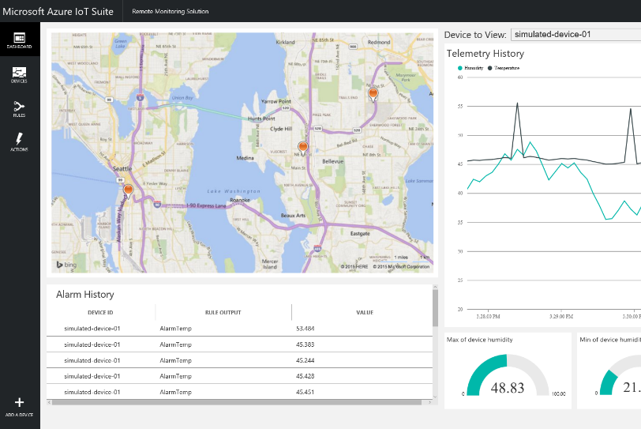

IoT Workshop Overview Hands On Labs
AMQP
Stream Analytics
Raspberry PI 3
Raspbien Linux
Azure Function

Slide 5

© 2014 Microsoft Corporation. All rights reserved. Microsoft, Windows, and other product names are or may be registered trademarks and/or trademarks in the U.S. and/or other countries.
The information herein is for informational purposes only and represents the current view of Microsoft Corporation as of the date of this presentation. Because Microsoft must respond to changing market conditions, it should not be interpreted to be a commitment on the part of Microsoft, and Microsoft cannot guarantee the accuracy of any information provided after the date of this presentation. MICROSOFT MAKES NO WARRANTIES, EXPRESS, IMPLIED OR STATUTORY, AS TO THE INFORMATION IN THIS PRESENTATION.

Slide 6
© 2014 Microsoft Corporation. All rights reserved. Microsoft, Windows, and other product names are or may be registered trademarks and/or trademarks in the U.S. and/or other countries.
The information herein is for informational purposes only and represents the current view of Microsoft Corporation as of the date of this presentation. Because Microsoft must respond to changing market conditions, it should not be interpreted to be a commitment on the part of Microsoft, and Microsoft cannot guarantee the accuracy of any information provided after the date of this presentation. MICROSOFT MAKES NO WARRANTIES, EXPRESS, IMPLIED OR STATUTORY, AS TO THE INFORMATION IN THIS PRESENTATION.

